Slide 1

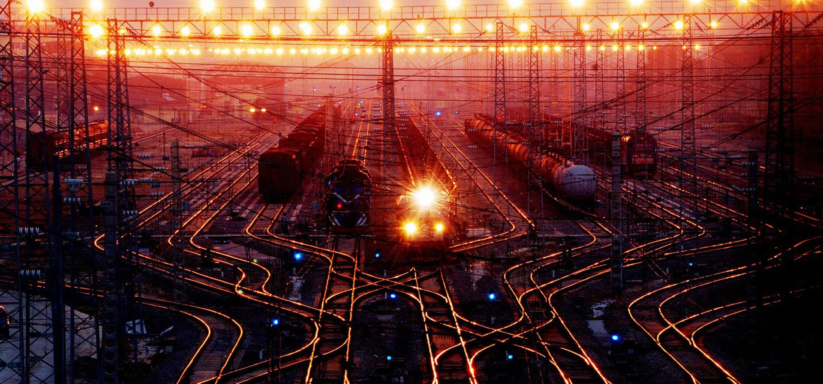
ELECTRONIC RAILWAY TICKET BOOKING
A PRESENTATION BYGROUP-12

Slide 2
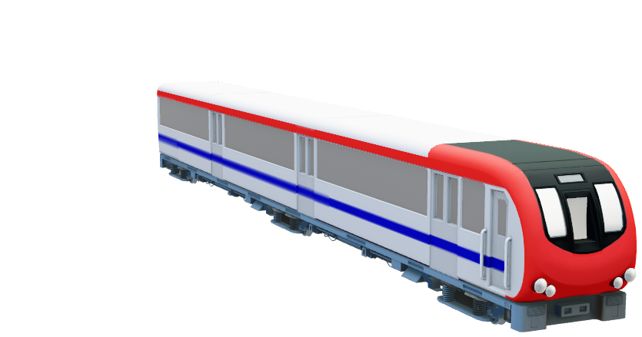
SRM UNIVERSITY ANDHRA PRADESH
Introduction to Programming Using C Project Report On
Electronic Railway Ticket Booking (ERTB PROJECT)
Submitted In Partial Fulfillment For The Award Of The Degree In
BACHELOR OF TECHNOLOGY
IN
COMPUTER SCIENCE AND ENGINEERING
Submitted by
Group:12 Section:C
1.Krishna Sai Raj Ponneboina AP21110010165
2. Milan Liju Mathew AP21110010166
3. Gopi Chand Medisetty AP21110010167
Under the guidance of
Mrs.Vidya V

Slide 3
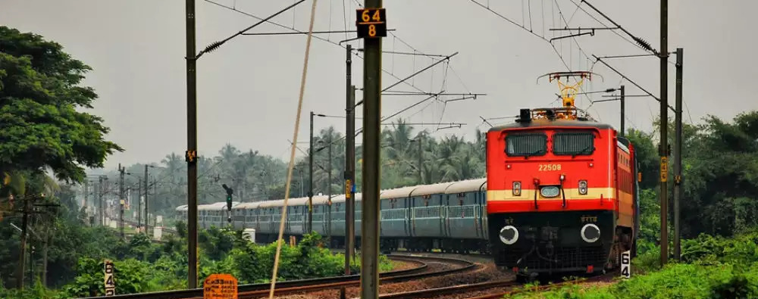

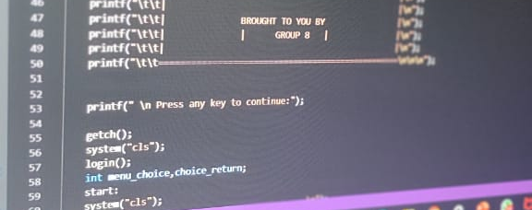
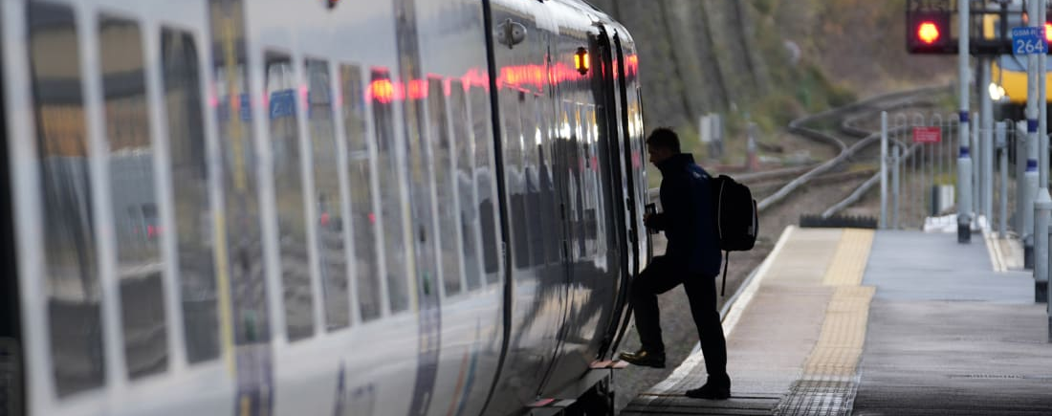
ABSTRACT
This System is basically concerned with the reservation of railway tickets to the passengers.
The main advantage of e-ticketing is the fact that you can book and print out the electronic system any time.
This System ensures the user to view trains of his desired destination, Reserve the ticket, Cancel the ticket, PNR Status, Food Services, etc.
This System is mainly used in the Traveling Agency who provide the train ticket reservation to passengers.
Railway Ticket reservation can easily accompanied with the help of this System.

Slide 4

INTRODUCTION
Project is based on a concept to reserve train tickets to go to various destinations.
Features include food services, accommodation, PNR Status , etc.
The admin can add, modify and can know about the cancellation
and information about all the trains.
This might be implemented in a real-world railway management system allow for faster data access and better waiting management.

Slide 5
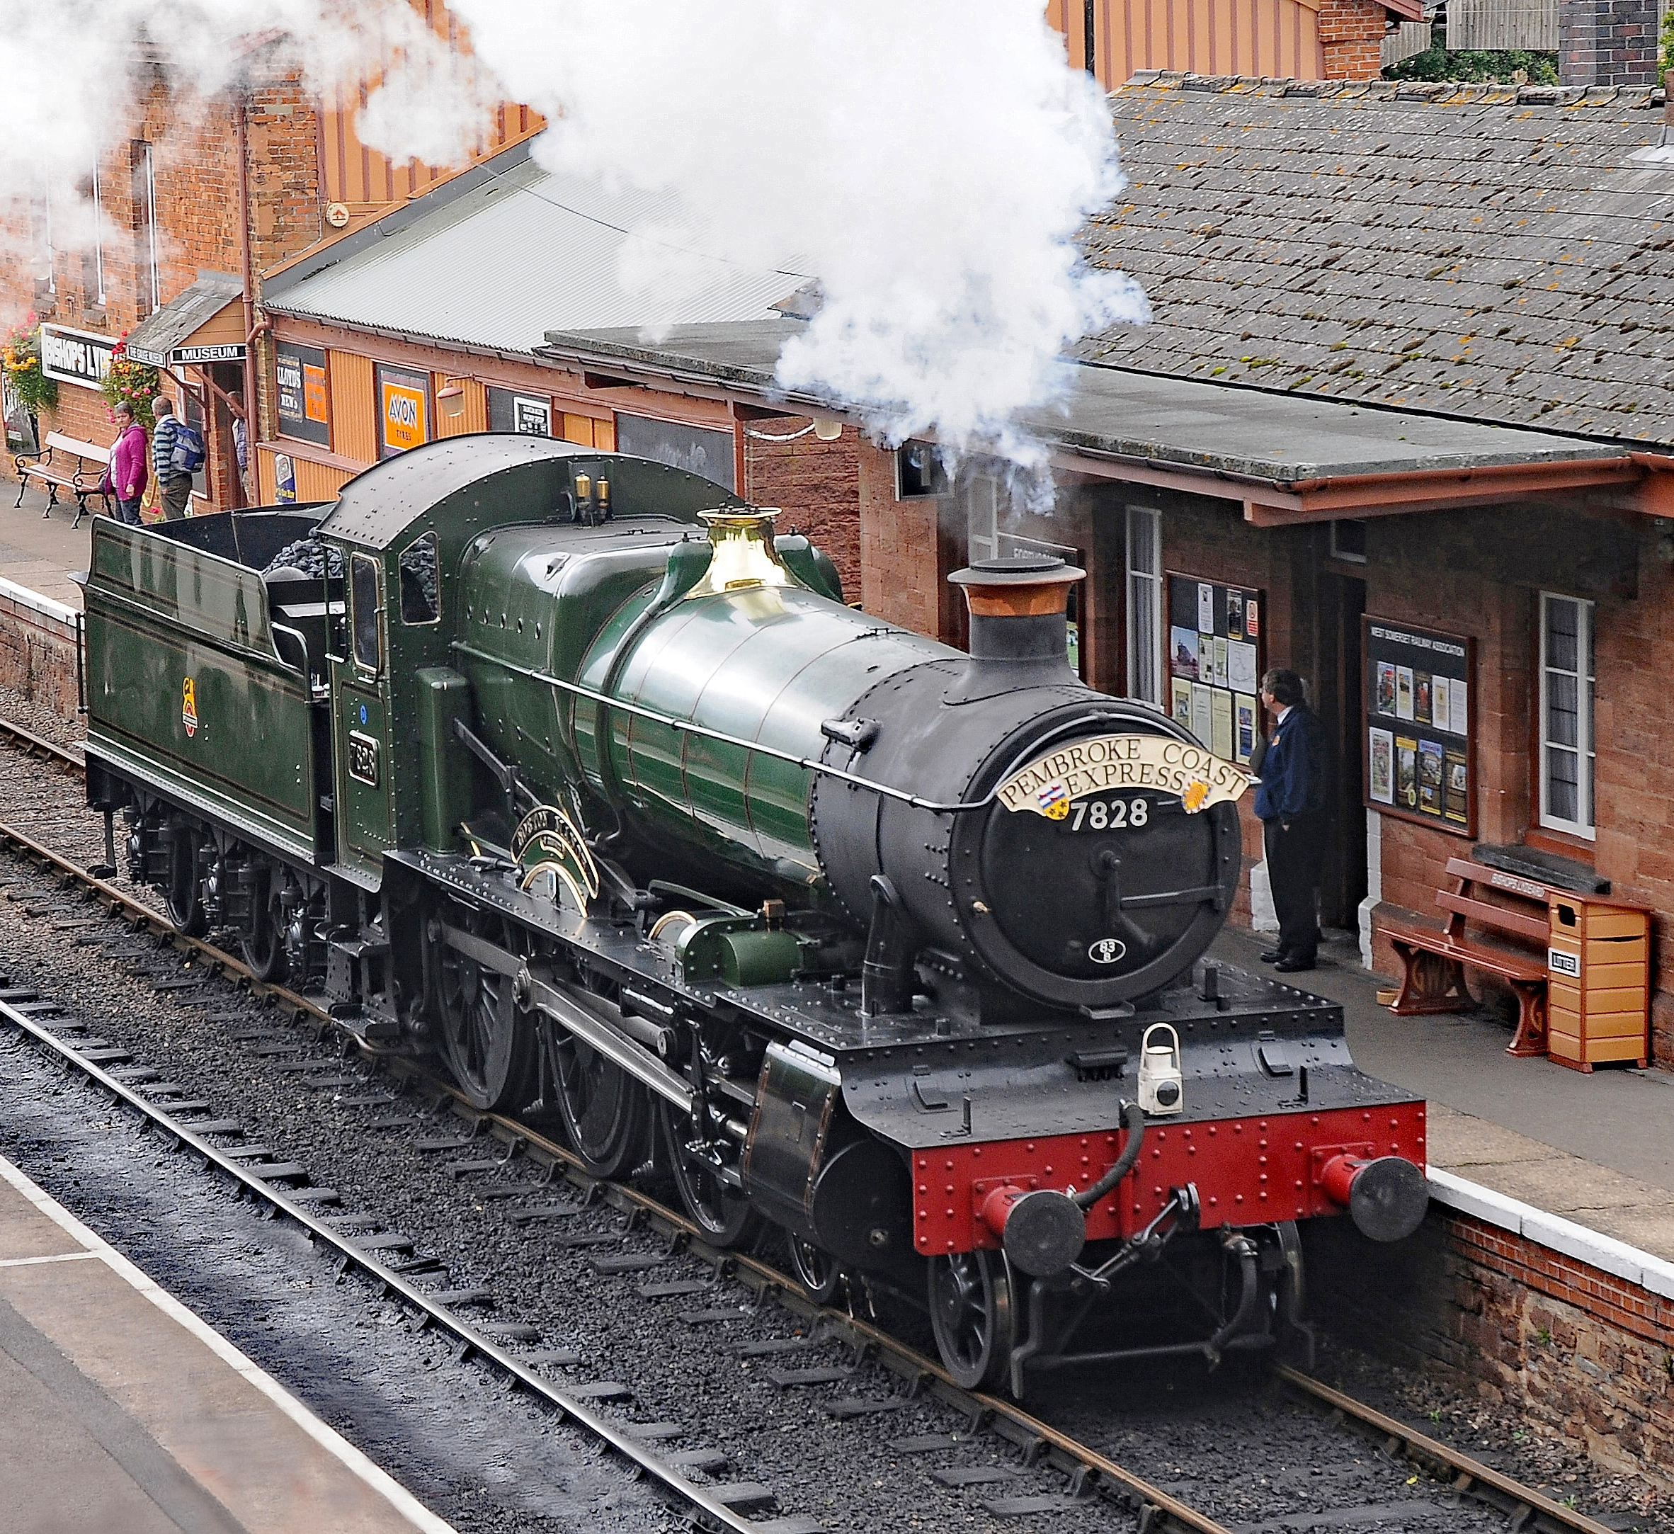
OBJECTIVE
To develop a system which will serve as a medium for people to book a ticket to travel through railways.
All the manual work should be converted into computerized so that load of employees should decrease.
The system is aimed to provide a easy interface to passenger to book the ticket

Slide 6
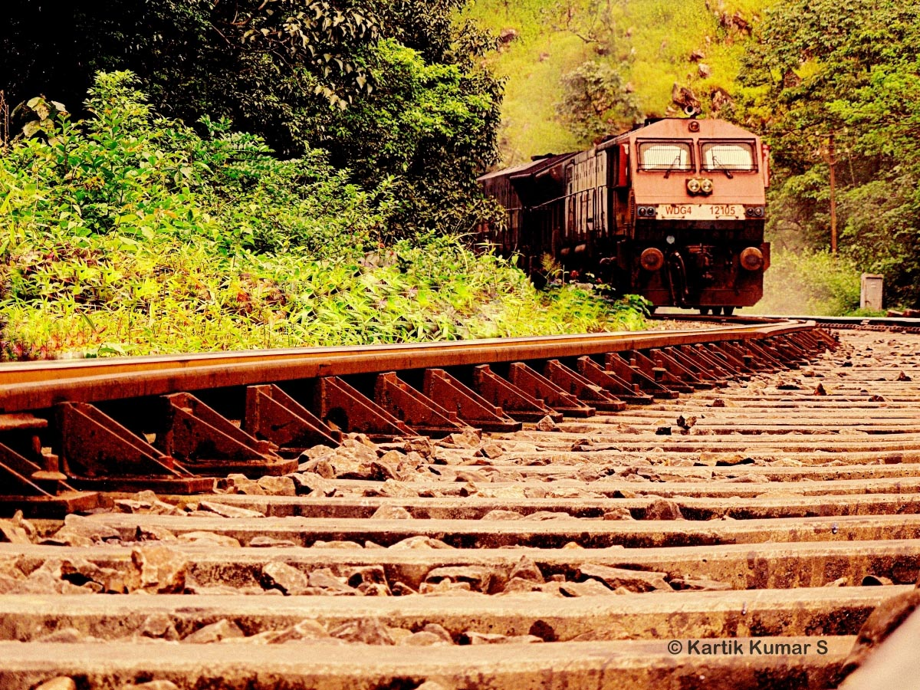

SYSTEM REQUIREMENTS
SOFTWARE REQUIREMENTS:
Language used: C
Operating System: Windows 7 Or Windows 10
Compiler: Vs Code, CodeChef, Codeblocks.
HARDWARE REQUIREMENTS:
Hard Disk: 512 GB (Minimum)
Processor: Intel-i3 (Minimum)

Slide 7
THANK YOU
ELECTRONIC RAILWAY
TICKET BOOKING
PRESENTED BY GROUP 12

